Slide 1
Fruitstand iCloud Storage Service

Slide 2
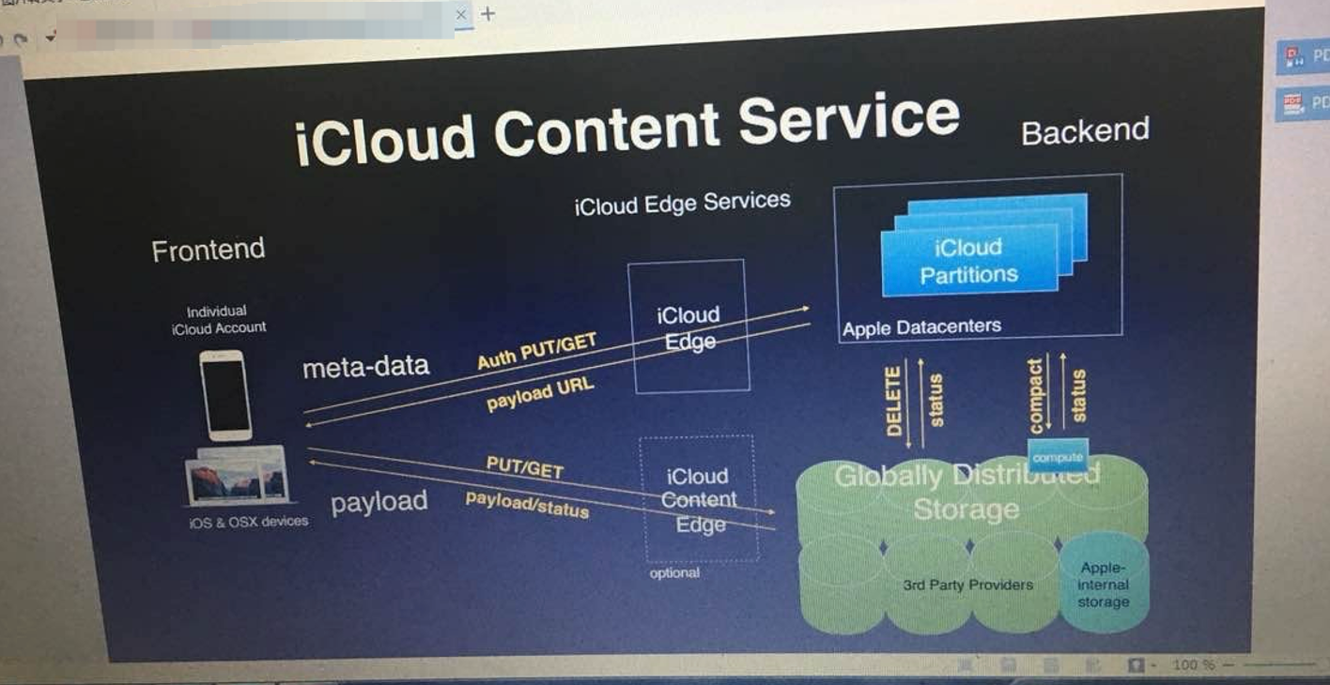
Components View Update
Confidential

Slide 3



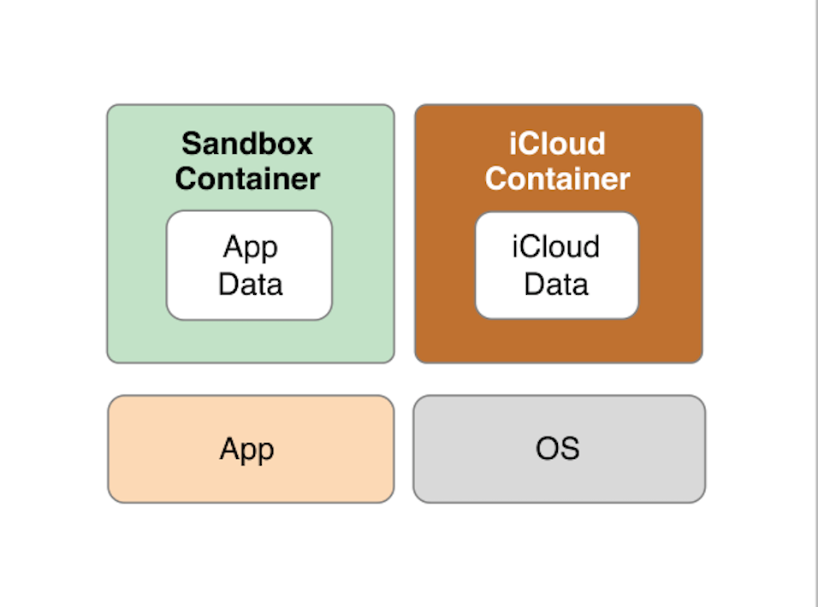

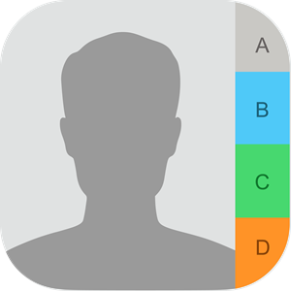

iCloud support content type
CloudKit
Backup
iCloud on Device
Ubiquity
6 Data Classes
PUT/GET/DELETE
Photo
iOS & OSX Devices
Contact
Calendar

Slide 4
iCloud China Current status
iCloud Edge Services
Metadata
iPhone/
iPad/
MAC
Auth Put/Get
iCloud Edge
iCloud Partitions
on Fruitstand China IDC
Payload URL
iCloud Paritions Services:
One partition store a group of user’s metadata
User Auth (AppleID)
Payload URL issuance to Device
Action(Delete/Compact) issuance to Global
Distributed Storage Service
Status sync
Compact
Status
Delete
Status
Global Distributed Storage:
Store 6 classes data, CloudKit^{[1]}(My Phone Stream)/Backup/Ubiquity^{[2]}/Photo Sharing/Contacts/Calendars
Currently 6 vendor
CT(China Telecom)/CM(China Mobile)/CU(China Unicom) provide self-build storage
Baidu/Alibaba/Tencent Cloud provide their
object storage
Compute Resource for Compacting
Global Distributed Storage
on Telco IDC & Public Cloud
iCloud Content Edge
Put/Get
China Telecom
China Mobile
China Unicom
Payload/Status
Baidu Cloud
Alibaba Cloud
Tencent Cloud
[1]Store IOS APP data https://developer.apple.com/cn/icloud/cloudkit/
[2]iCloud Container https://developer.apple.com/library/archive/documentation/General/Conceptual/iCloudDesignGuide/Chapters/iCloudFundametals.html
Optional

Slide 5
iCloud pricing in China
¥6/Month – 50GB
¥21/Month – 200GB
¥68/Month – 2TB

Slide 6
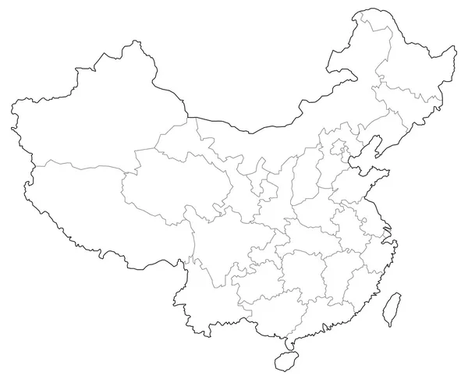


Distance between AWS Region and Fruitstand iCloud Data Center
Straight Distance:
FS North IDC between AWS Beijing about 307KM
FS North IDC between AWS Ningxia about 788KM
FS South IDC between AWS Beijing about 1659KM
FS South IDC between AWS Ningxia about 1155KM
FS North IDC between FS South IDC about 1623KM
Fruitstand
North IDC
AWS Beijing
AWS Ningxia
Fruitstand
South IDC

Slide 7
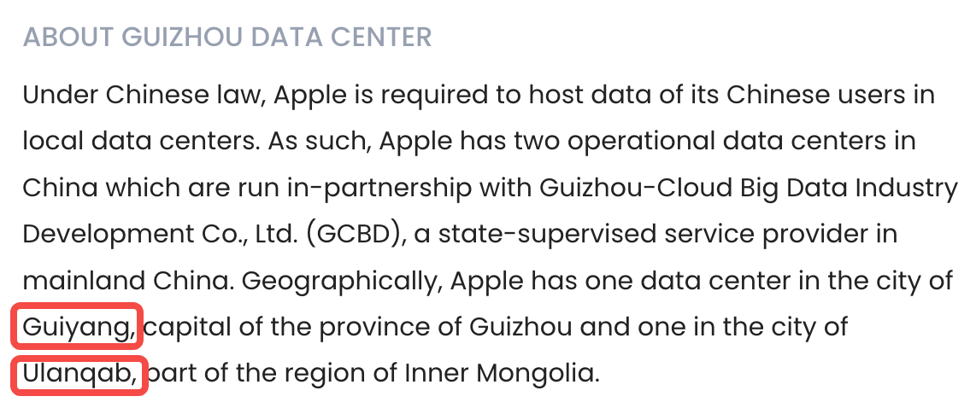
SA insight – iCloud Storage has ran for 6 years
Currently 6 Storage vendors：
China Telco – Self-build Storage
China Mobile – Self-build Storage
China Unicom – IBM storage, but will use self-build too
Baidu Cloud – Object storage
Alibaba Cloud - Object storage
Tencent
2023-05-11, Apple officially updated the global Apple service status information at around 5:15 pm Beijing time on May 11, 2023. The company acknowledged that the "iCloud Account and Sign In" and "iCloud Mail" services experienced an outage from 3:27 pm to 4:10 pm.
2009 Fruitstand worked with China Unicom selling iPhone 3GS
Only find iCloud Global Outage information,
no iCloud China Outage information.
2018-02-28 Fruistand migrate all China user’s data from US to China Guizhou Cloud
https://www.datacenters.com/apple-inc-guizhou
https://www.163.com/dy/article/H271OVBV051180F7.html

Slide 8
iCloud Storage Draft RFI Study
GAPS | Draft RFI Terms | AWS S3 Standard Spec.
1 | Durability 99.9999999999% (12 9’s) | S3 provide 11 9's durability
2 | Must support at least two copies written on PUT when the service responds OK, and then in less than 15 mins we needs to be in sync with another data center no less than 50 miles/ 80 km away | S3 store data in 3 AZ in each region to ensure data durability. Currently, BJS and ZHY data centers ad-hoc distance is up to 60 miles, not 100% sure no less than 80KM
3 | Concurrent connections Supplier will provide access to a real-time performance graph showing the concurrent connections per second, with maximum five-minute delay. | S3 provide concurrent number of API in minutes in CloudWatch or Bucket metrics
4 | User Access Log Reports. Supplier will provide XXXXX with W3C-formatted (http:// www.w3.org/TR/WD-logfile.html) access logs. | S3 log do not support W3C format

Slide 9
Storage requirement from China Mobile PFI
Item | Value | Comments
Possible S3 storage size | 300PB | China Mobile’s quota
Object average Size | 2MB | MiCloud is 4MB
Daily total Put size | 1~1.5PB | Follow two slides will list the requirement detail
Put peak QPS | 12.5K/s | Impact S3 Upstream bandwidth
Get peak QPS | 11K/s | Impact S3 Downstream bandwidth
Delete peak QPS | 22K/s | S3 doesn’t have Delete API charge

Slide 10
Daily total Put object size 1PB Scenario
Daily total Put object size 1PB Scenario
Total Size | 1048576 | GB | Data source
Object average Size | 2 | MB
Put peak QPS | 12500 | Per second
Get peak QPS | 11000 | Per second
Delete peak QPS | 22000 | Per second
Technique Requirements
S3 Daily Put total request | 536870912 |  | S3 Daily Put API total
S3 DTI | 1048576 | GB
S3 Upstream bandwidth requirement | 195.3125 | Gbps
S3 Daily Get total request | N/A |  | S3 Daily Get API total
S3 DTO | N/A |  | Depend on Get total request
S3 Downstream bandwidth requirement | 171.875 | Gbps
Conclusion:
S3 bandwidth at lease 195Gbps
S3 DTO is unknown, but this item is already included in PPA as 1/15 of DTI

Slide 11
Daily total Put object size 1PB Scenario
Daily total Put object size 1PB Scenario
Total Size | 1572864 | GB | Data source
Object average Size | 2 | MB
Put peak QPS | 12500 | Per second
Get peak QPS | 11000 | Per second
Delete peak QPS | 22000 | Per second
Technique Requirements
S3 Daily Put total request | 805306368 |  | S3 Daily Put API total
S3 DTI | 1572864 | GB
S3 Upstream bandwidth requirement | 195.3125 | Gbps
S3 Daily Get total request | N/A |  | S3 Daily Get API total
S3 DTO | N/A |  | Depend on Get total request
S3 Downstream bandwidth requirement | 171.875 | Gbps
Conclusion:
S3 bandwidth at lease 195Gbps
S3 DTO is unknown, but this item is already included in PPA as 1/15 of DTI

Slide 12








BYON potential proposals – With Telco Partner, reduce the more Storage cost
Deal Structure |  | Plan A: BYON | Plan B: BYON+New Data Center
All-in-one-price = Telco Network + AWS S3 |  | S3 end point IPs would be provided by Telco. New dedicated internet trucks for DTO of fruitstand Telco project, no charge for AWS from Telco. | S3 end point Ips would be provided by Telco. New data center infra to meet 80KM, dedicated for fruitstand project S3. Cost under discussion. Dedicated Interlink and Internet trucks, no charge for AWS from Telco.
all-in-one-price
AWS Region
AWS Region
TC
TC
TC
TC
Border Network
Border Network
Subcontractor
S3 price
New
AZ-a
AZ-c
Data
Center
AZ-a
AZ-b
AZ-c
AZ-b
80KM

